Slide 1

Gen-AI

Slide 2
Day 2 - Python

Slide 3

Syllabus
Pre Training – Variables, Data Types, Operators
Training
1. Topics: Conditional statements (if-elif-else), loops (for, while), and logical operators.
2. Hands-On: Write a guessing game using loops and conditions.
Post Training – Case Study: Create a simple calculator that performs basic arithmetic based on user input.

Slide 4
Python Variables
In Python, variables are just memory locations to store values
Variables are dynamically typed, meaning that the type is determined at runtime based on the assigned value.
You can define a variable dynamically: x
You can assign a value to the variable directly: x=10
You can check the memory location of a variable using the id(variable) function
You can check the type of a variable using the type(variable) function
You can check the type of a variable using the isint(variable) function
You can change the datatype of a variable using the int(variable) function

Slide 5
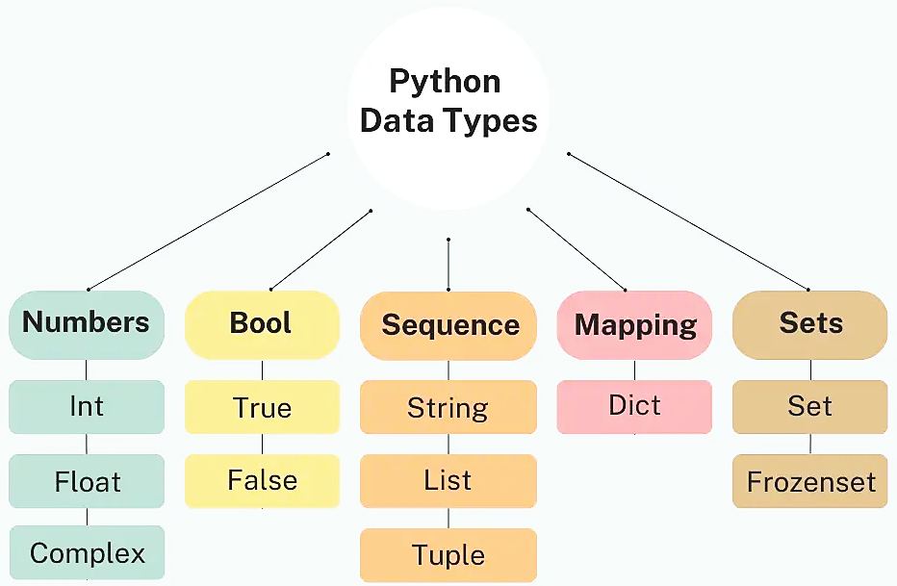
Python Data Types

Slide 6
Data types in Python
Numeric Types
int: Represents signed integers of arbitrary size.
float: Represents floating-point numbers, which can include decimal points.
complex: Represents complex numbers, written as a+bj where a is the real part and b is the imaginary part.
Sequence Types
str: A sequence of characters used to represent text.
list: An ordered collection of items that can be of different types, mutable (can be changed).
tuple: Similar to lists but immutable (cannot be changed after creation).
range: Represents a sequence of numbers, commonly used in loops.
Mapping Type
dict: A collection of key-value pairs, where each key is unique. Useful for associative arrays.

Slide 7
Data types in Python
Set types
set: An unordered collection of unique items. Supports membership testing & eliminating duplicate entries.
frozenset: Similar to set, but immutable.
Boolean type
bool: Represents one of two values: True or False, often used in conditional statements.
Binary types
bytes: Immutable sequences of bytes, used for binary data.
bytearray: Mutable sequences of bytes.
memoryview: View the memory of another binary object, to manipulate without copying
None type
None Type: Represents the absence of a value or a null value, denoted by None.

Slide 8
Data types in Python
# Numeric Types
x = 42 # int
y = 3.14159 # float
z = 1 + 2j # complex
print(f"Integer: {x}, Float: {y}, Complex: {z}")
# Sequence Types
text = "Hello, Python!" # str
fruits = ["apple", "banana", "cherry"] # list
coordinates = (10, 20, 30) # tuple
numbers = range(1, 5) # range
print(f"String: {text}, List: {fruits}, Tuple: {coordinates}, Range: {list(numbers)}")
# Set Types
unique_numbers = {1, 2, 3, 4} # set
frozen_set = frozenset([1, 2, 3, 4]) # frozenset
print(f"Set: {unique_numbers}, Frozen Set: {frozen_set}")
# Mapping Type
person = {"name": "Alice", "age": 25} # dict
print(f"Dictionary: {person}")
# Binary Types
byte_data = b"Hello" # bytes
mutable_bytes = bytearray(b"World") # bytearray
mem_view = memoryview(byte_data) # memoryview
print(f"Bytes: {byte_data}, Bytearray: {mutable_bytes}, Memoryview: {mem_view.tobytes()}")
# Boolean Type
is_valid = True
is_expired = False
print(f"Boolean: {is_valid}, {is_expired}")
# None Type
value = None
print(f"None Type: {value}")

Slide 9
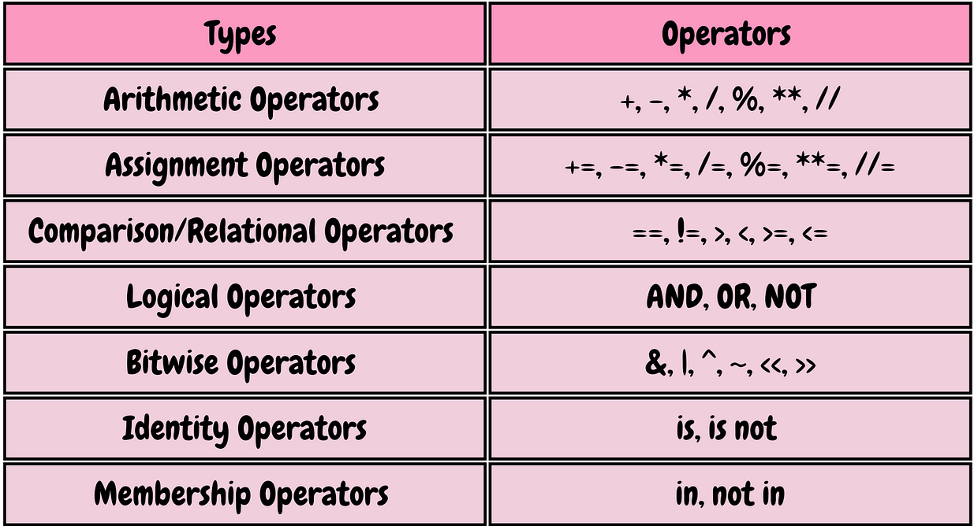
Python Operators

Slide 10
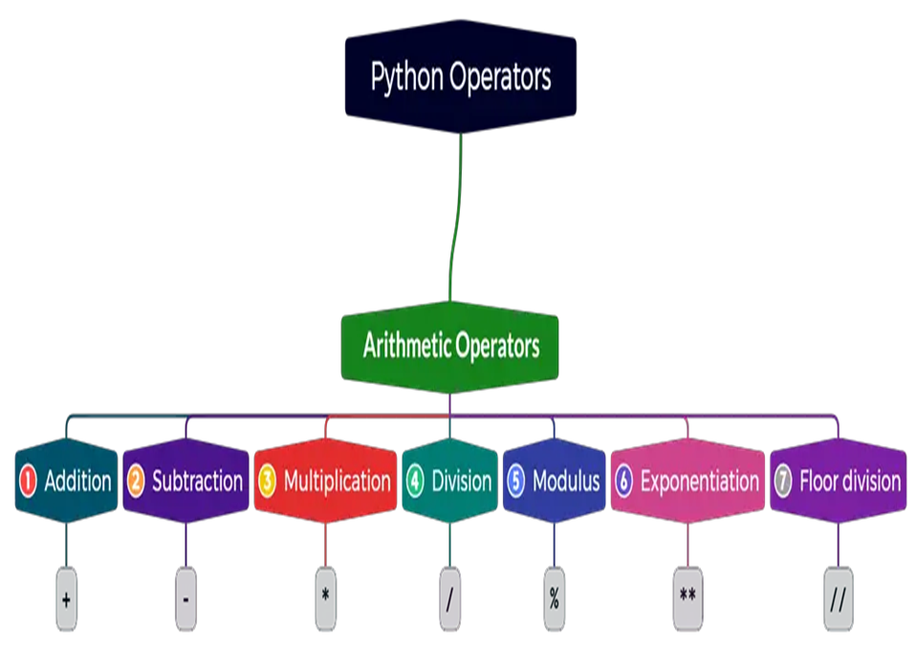
1. Arithmetic Operators
Arithmetic operators are used for performing mathematical calculations.
Addition (+): Adds two operands.
Subtraction (-): Subtracts the second operand from the first.
Multiplication (*): Multiplies two operands.
Division (/): Divides the first operand by the second, returning a float.
Modulus (%): Returns the remainder of the division.
Exponentiation (**): Raises the first operand to the power of the second.
Floor Division (//): Divides and returns the largest integer less than or equal to result

Slide 11
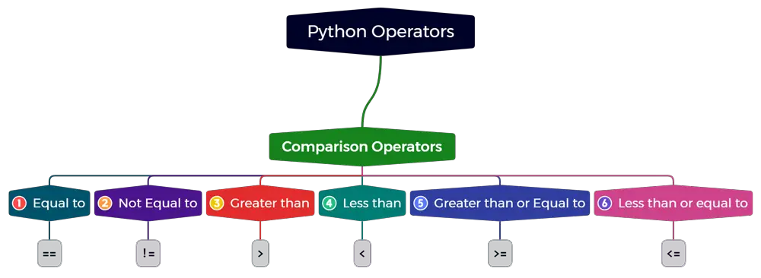
2. Comparison Operators
Comparison operators compare two values and return a Boolean value.
Equal to (==): Checks if two operands are equal.
Not equal to (!=): Checks if two operands are not equal.
Less than (<): Checks if the left operand is less than the right.
Less than or equal to (<=): Checks if the left operand is less than or equal to the right.
Greater than (>): Checks if the left operand is greater than the right.
Greater than or equal to (>=): Checks if left operand is greater than or equal to right.

Slide 12
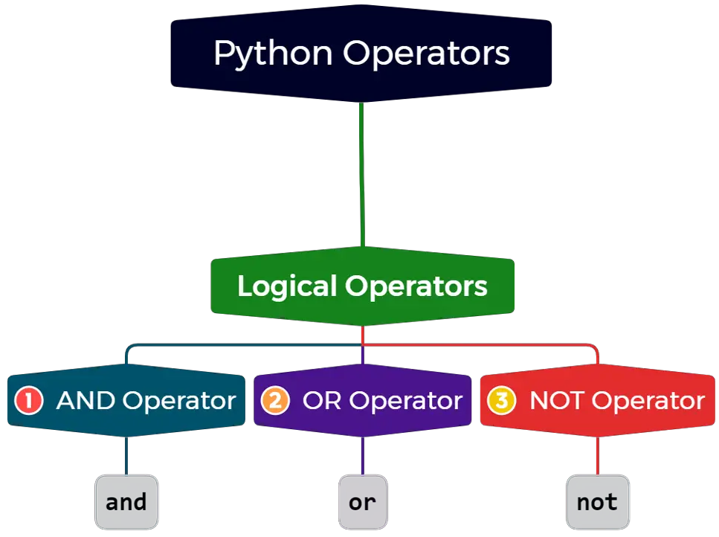
3. Logical Operators
Logocal operators are used to combine conditional statements.
AND (and): Returns True if both statements are true.
OR (or): Returns True if at least one statement is true.
NOT (not): Reverses the result, returns True if the statement is false.

Slide 13
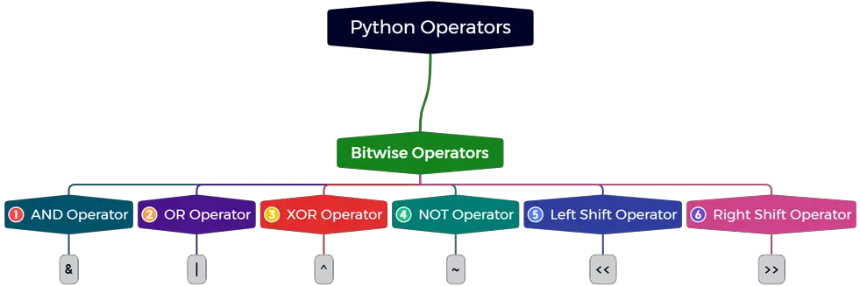
4. Bitwise Operators
Bitwise operators perform operations on bits and used for low-level programming.
Bitwise AND (&): Performs AND operation on each bit.
Bitwise OR (|): Performs OR operation on each bit.
Bitwise XOR (^): Performs XOR operation on each bit.
Bitwise NOT (~): Inverts all bits.
Left Shift (<<): Shifts bits to the left, filling with zeros from the right.
Right Shift (>>): Shifts bits to the right.

Slide 14
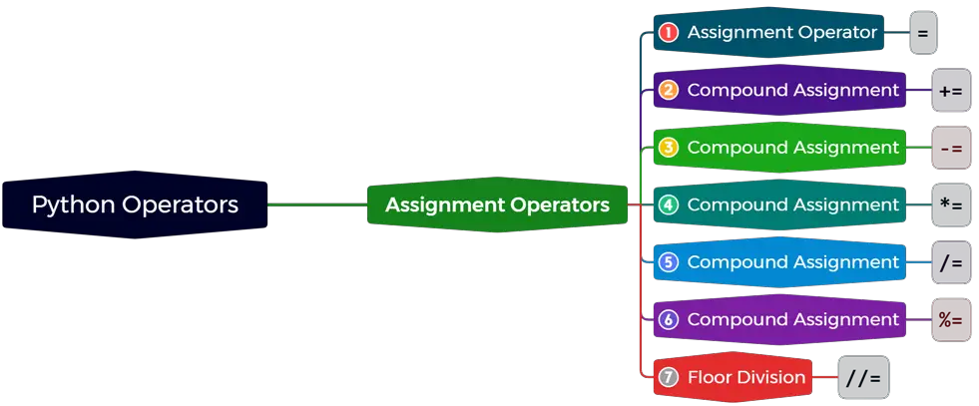
5. Assignment Operators
Assignment operators assign values to variables.
Assignment (=): Assigns a value to a variable.
Add and assign (+=): Adds and assigns the result to a variable.
Subtract and assign (-=): Subtracts and assigns the result to a variable.
Multiply and assign (*=): Multiplies and assigns the result to a variable.
Divide and assign (/=): Divides and assigns the result to a variable.

Slide 15
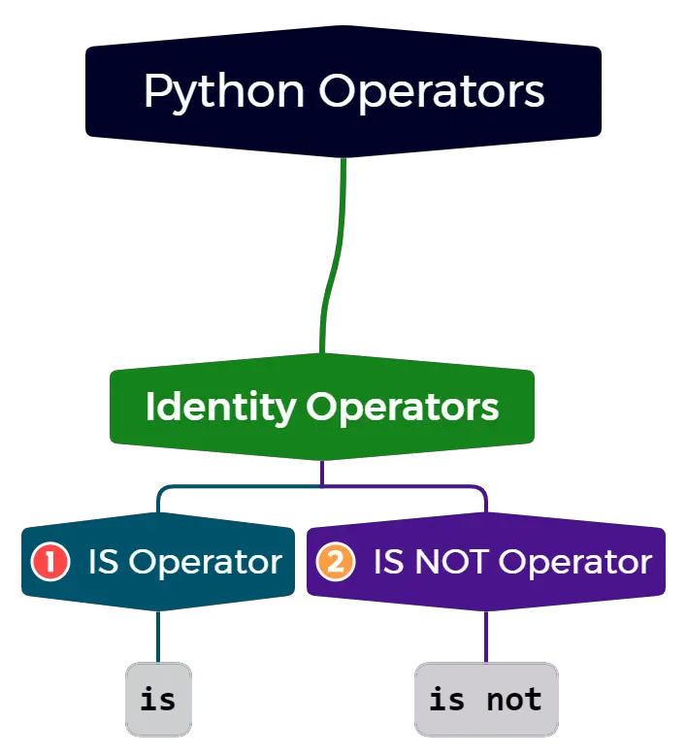
6. Identity Operators
Identity operators check whether two variables point to the same object in memory. id(variable)
Identity (is): Returns True if both variables point to the same object.
Not identity (is not): Returns True if both variables do not point to the same object.

Slide 16
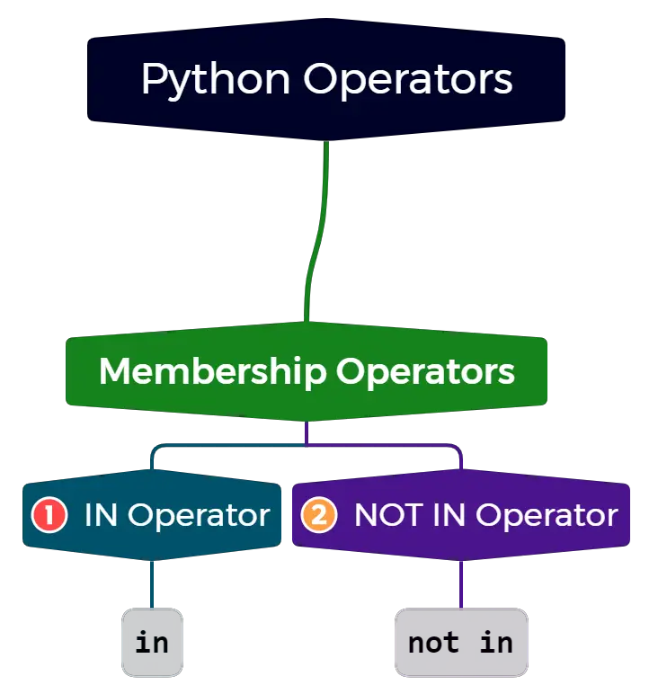
7. Membership Operators
Membership operators test for membership in sequences like lists, strings, or tuples.
In (in): Returns True if a value is found in a sequence.
Not in (not in): Returns True if a value is not found in a sequence.

Slide 17
Operators in Python
# Arithmetic Operators
a = 10
b = 3
print("Arithmetic Operations:")
print(f"{a} + {b} = {a + b}") # Addition
print(f"{a} - {b} = {a - b}") # Subtraction
print(f"{a} * {b} = {a * b}") # Multiplication
print(f"{a} / {b} = {a / b}") # Division
print(f"{a} % {b} = {a % b}") # Modulus
print(f"{a} ** {b} = {a ** b}") # Exponentiation
print(f"{a} // {b} = {a // b}") # Floor Division
# Comparison Operators
print("\nComparison Operations:")
print(f"{a} == {b}: {a == b}") # Equal to
print(f"{a} != {b}: {a != b}") # Not equal to
print(f"{a} < {b}: {a < b}") # Less than
print(f"{a} <= {b}: {a <= b}") # Less than or equal to
print(f"{a} > {b}: {a > b}") # Greater than
print(f"{a} >= {b}: {a >= b}") # Greater than or equal to
# Logical Operators
x = True
y = False
print("\nLogical Operations:")
print(f"x and y: {x and y}") # AND
print(f"x or y: {x or y}") # OR
print(f"not x: {not x}") # NOT
# Bitwise Operators
c = 5 # (binary: 0101)
d = 3 # (binary: 0011)
print("\nBitwise Operations:")
print(f"c & d = {c & d}") # Bitwise AND
print(f"c | d = {c | d}") # Bitwise OR
print(f"c ^ d = {c ^ d}") # Bitwise XOR
print(f"~c = {~c}") # Bitwise NOT (inverts bits)
print(f"c << 1 = {c << 1}") # Left Shift
print(f"c >> 1 = {c >> 1}") # Right Shift
# Assignment Operators
e = 10
print("\nAssignment Operations:")
e += 5 # Equivalent to e = e + 5
print(f"e after += 5 : {e}")
e -= 3 # Equivalent to e = e - 3
print(f"e after -= 3 : {e}")
# Identity Operators
f = [1, 2, 3]
g = f
print("\nIdentity Operations:")
print(f"f is g : {f is g}") # True, both refer to same object
h = f[:]
print(f"f is h : {f is h}") # False, h is a copy of f
# Membership Operators
list1 = [1, 2, 3, 4]
print("\nMembership Operations:")
print("2 in list1:", 2 in list1) # True, as 2 is in list1
print("5 not in list1:", 5 not in list1) # True, as 5 is not in list1

Slide 18
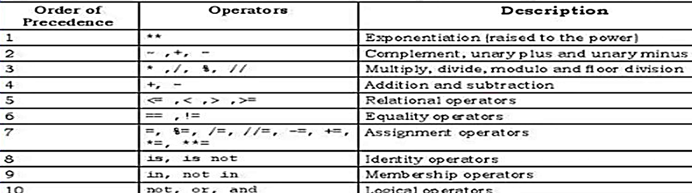
Python Operators – Order of Precedence

Slide 19
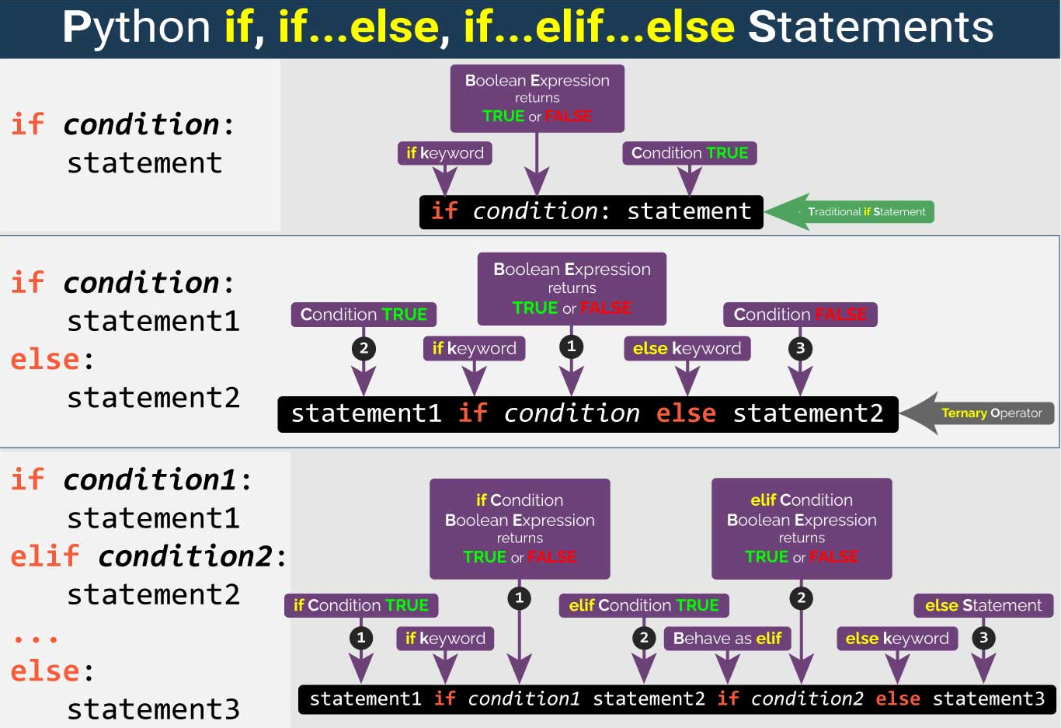
Branching Statements

Slide 20
Branching
Branching in Python allows the execution of specific blocks of code based on certain conditions.
It allows different parts of a program to execute depending on whether specific conditions are met.
This decision-making capability is essential for creating dynamic and responsive applications.
Python's branching is implemented using conditional statements such as if, if-else, and if-elif-else.

Slide 21
Types of Branching – if Statement
if Statement:
The simplest form of branching, the if statement evaluates a condition (a boolean expression)
If the condition evaluates to True, the block of code following the if statement is executed.
If the condition is False, the block is skipped.
age = 18
if age >= 18:
print("You are eligible to vote.")

Slide 22
Types of Branching – if-else Statement
2. if-else Statement
The if-else statement executes one block of code if the condition is True, and another block if the condition is False.
The else statement follows an if statement and executes a block of code when the condition in the if statement is False.
number = 10
if number % 2 == 0:
print("Even number")
else:
print("Odd number")

Slide 23
Types of Branching – if-elif-else Statement
3. if-elif-else Statement
The elif (short for "else if") statement allows you to check multiple conditions.
It is used after an if statement to check another condition if the previous one was false.
If one condition is True, its corresponding block is executed, and the rest are ignored.
marks = 85
if marks >= 90:
print("Grade: A")
elif marks >= 80:
print("Grade: B")
elif marks >= 70:
print("Grade: C")
else:
print("Grade: F")

Slide 24
Types of Branching – Nested if Statements
4. Nested if Statements
You can nest if statements within other if statements, allowing for more complex decision-making processes.
age = 20
citizen = True
if age >= 18:
if citizen:
print("You are eligible to vote.")
else:
print("You need to be a citizen to vote.")
else:
print("You are not old enough to vote.")

Slide 25
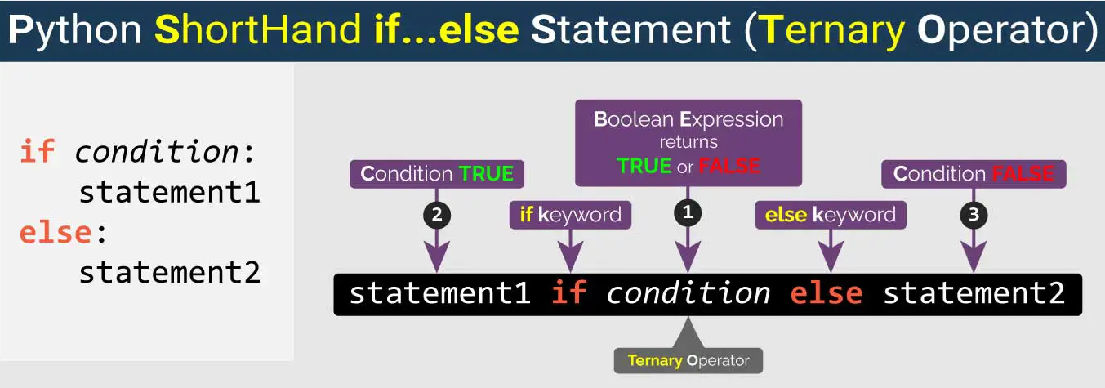
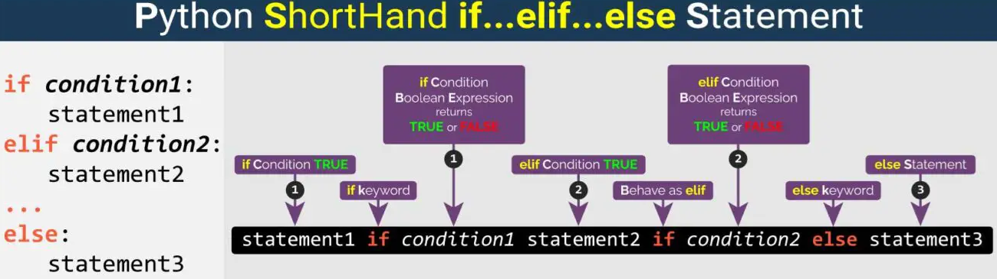
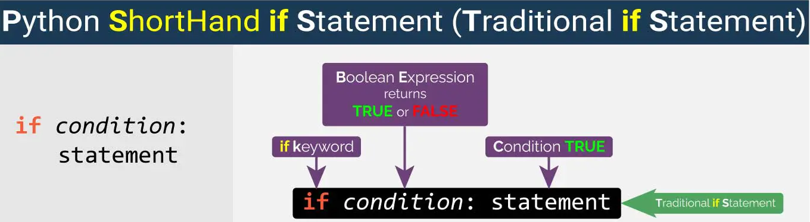
Types of Branching – One line Branching
One-Line Branching:
x = 10
result = "Positive" if x > 0 else "Negative"
print(result)

Slide 26
Types of Branching – Logical Operators in Branching
6. Logical Operators in Branching
Logical operators (and, or, not) allow combining multiple conditions, for more complex conditional expressions.
and: True if both conditions are true.
or: True if at least one of the conditions is true.
not: Reverses the truth value of a condition.
# Checking for even or odd number
number = int(input("\nEnter a number to check if it's even or odd: "))
if number % 2 == 0:
print(f"{number} is an even number.")
else:
print(f"{number} is an odd number.")

Slide 27
Types of Branching
# 1. Simple `if` Statement
temperature = 30
if temperature > 25:
print("It's hot outside!")
# 2. `if-else` Statement
number = 10
if number % 2 == 0:
print("Even number")
else:
print("Odd number")
# 3. `if-elif-else` Statement
marks = 85
if marks >= 90:
print("Grade: A")
elif marks >= 80:
print("Grade: B")
elif marks >= 70:
print("Grade: C")
else:
print("Grade: F")
# 4. Nested `if` Statements
age = 20
citizen = True
if age >= 18:
if citizen:
print("You are eligible to vote.")
else:
print("You need to be a citizen to vote.")
else:
print("You are not old enough to vote.")
# 5. One-Line Branching
x = -5
result = "Positive" if x > 0 else "Negative"
print(f"x is {result}")
# 6. Logical Operators in Branching
is_registered = True
if age >= 18 and is_registered:
print("You can vote.")
else:
print("You cannot vote.")
# 7. Real-World Example: Traffic Light
traffic_light = "red"
if traffic_light == "green":
print("Go!")
elif traffic_light == "yellow":
print("Slow down!")
elif traffic_light == "red":
print("Stop!")
else:
print("Invalid traffic light signal.")
# 8. Error Handling Using Branching
try:
number = int(input("Enter a number: "))
if number > 0:
print("You entered a positive number.")
elif number < 0:
print("You entered a negative number.")
else:
print("You entered zero.")
except ValueError:
print("That's not a valid number!")

Slide 28
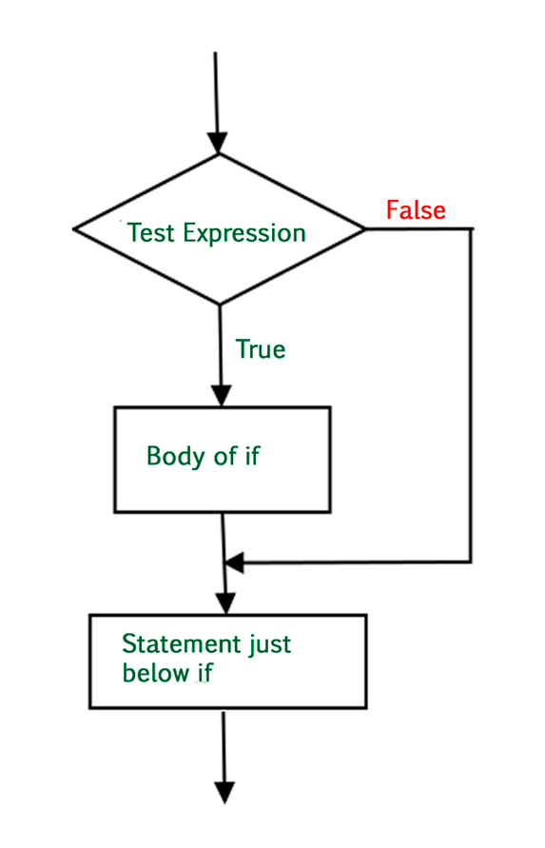
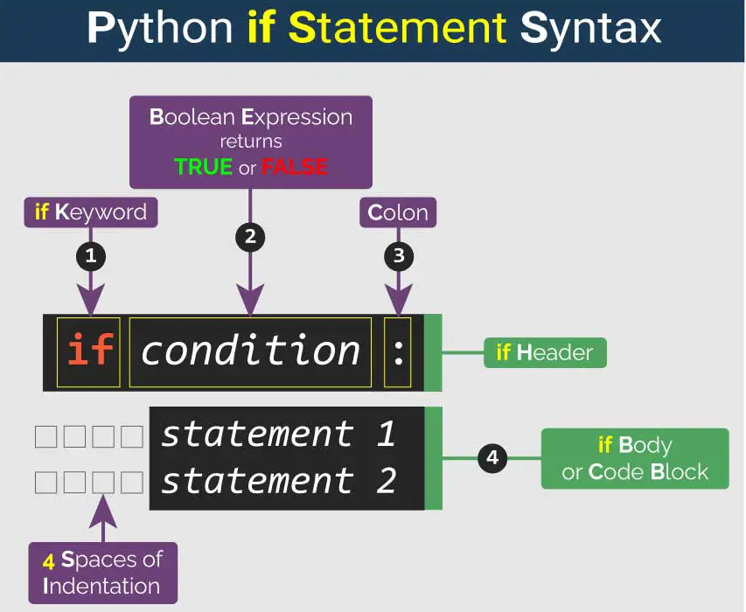
If condition

Slide 29
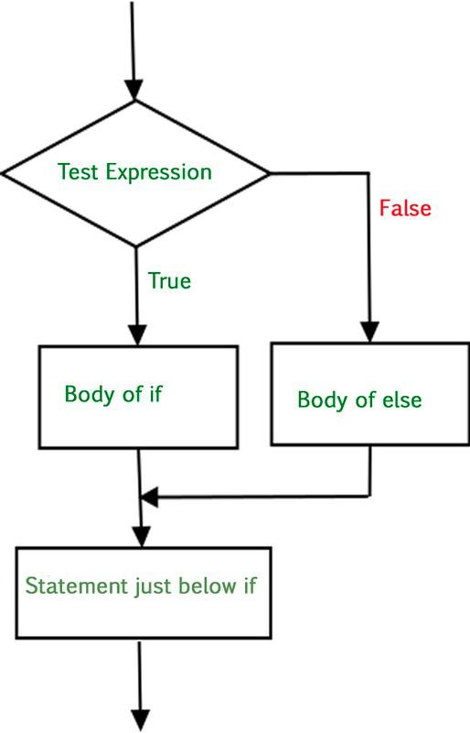
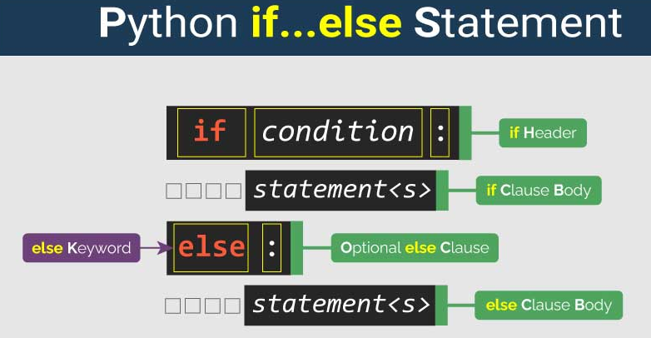
If-else conditions

Slide 30
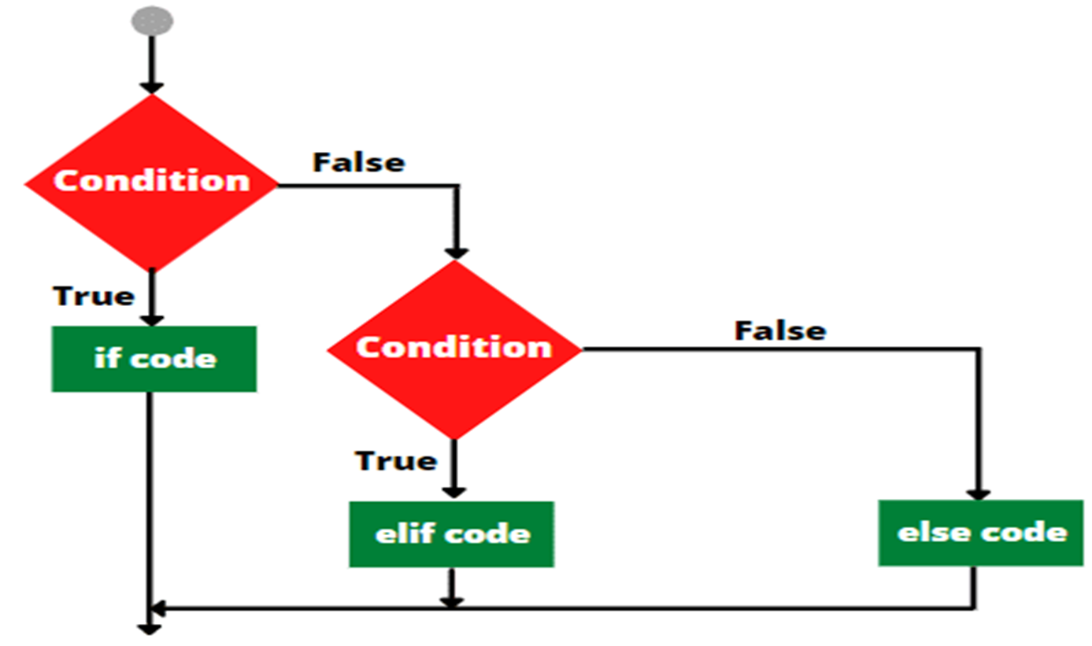
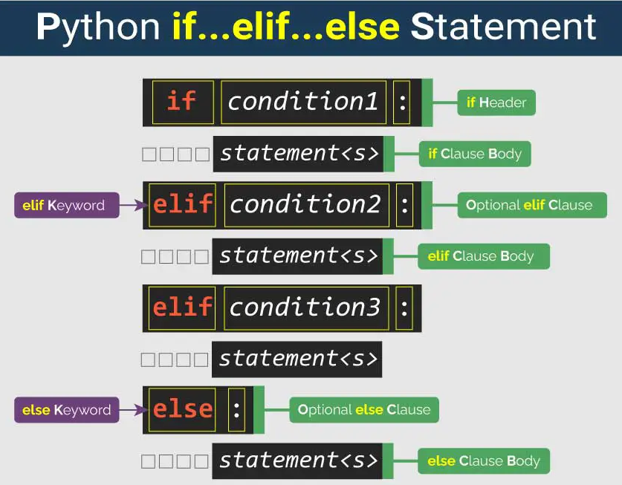
if-elif-else statement

Slide 31
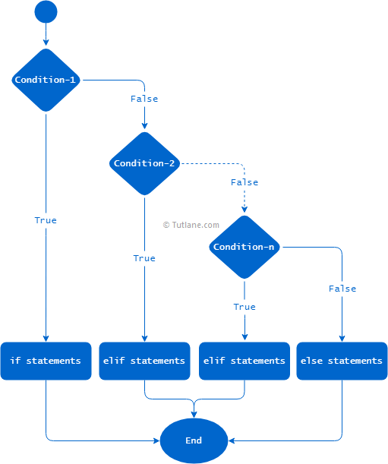
if-elif-elif-else statements

Slide 32
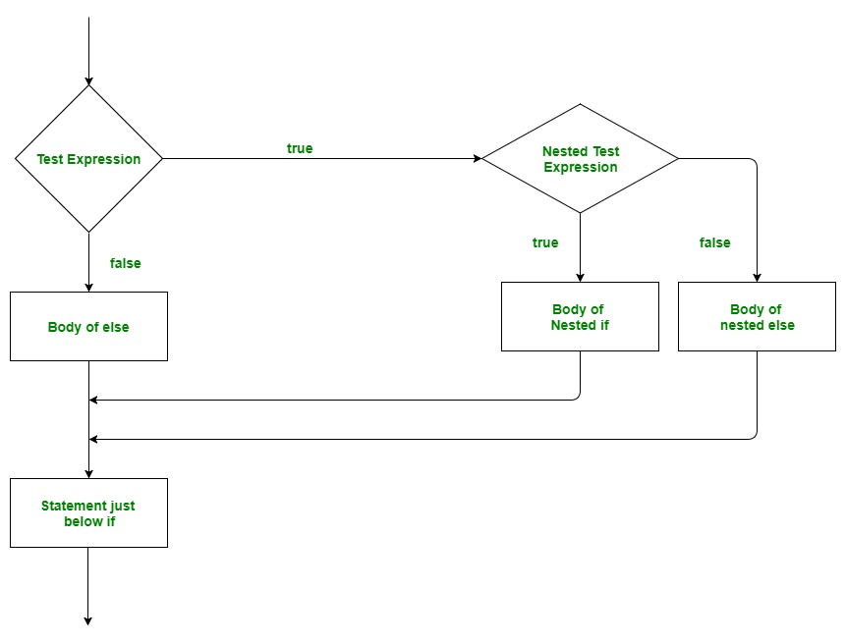
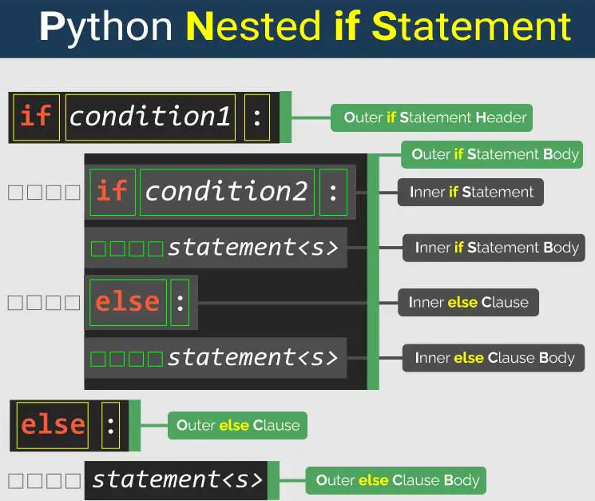
Nested if conditions

Slide 33
Python Loops
Loops in Python are control flow statements that repeatedly execute a block/s of code as long as a condition is true or for a specific range of values.
Loops are widely used for applications, such as:
Iterating through collections (lists, strings, dictionaries).
Performing repetitive calculations.
Processing data streams.
Implementing algorithms that require repeated actions until conditions are met.
Loops can be nested within other loops, allowing for complex iteration patterns. The inner loop executes completely for each iteration of the outer loop. Nested Loop structure is used to work with multi-dimensional data structures as matrices
Infinite Loops never terminate, due to a intentional program design (TV remote)

Slide 34
Python – While Loop
The while loop continues to execute a block of code as long as a specified condition remains true.
Usage: This type of loop is useful when the number of iterations is not predetermined and depends on dynamic conditions.
Condition Checking: Before each iteration, the condition is checked. If it evaluates to True, the loop body executes; if it evaluates to False, the loop terminates.
Infinite Loops: If the condition never becomes false, a while loop can run indefinitely.
Else Clause: Similar to for loops, while loops can also have an optional else clause that executes when the loop condition becomes false.

Slide 35
Python – For Loop
The for loop in Python iterates over a sequence (like a list, tuple, dictionary, set, or string) or any iterable object.
Usage: This type of loop is useful when the number of iterations is known or when you want to process each item in a collection.
Iteration: The process of traversing through the elements of a sequence is known as iteration. In a for loop, a variable is assigned to each item in the sequence one at a time, allowing you to execute a block of code for each item.
Range Function: Often, for loops utilize the range() function to generate a sequence of numbers. This function can specify the start, stop, and step values, making it flexible for various counting needs.
Else Clause: Python allows an optional else clause with for loops. This block executes after the loop completes normally

Slide 36
Loop Control Statements
Python provides several control statements that modify the behavior of loops:
Break Statement: The break statement immediately terminates the loop and transfers control to the next statement following the loop. It can be used to exit from both for and while loops prematurely.
Continue Statement: The continue statement skips the current iteration and proceeds with the next iteration of the loop. This can be useful for skipping specific values or conditions without terminating the entire loop.
Pass Statement: The pass statement serves as a placeholder that does nothing when executed. It can be used in loops (or other blocks) where syntactically some code is required but no action needs to be taken.

Slide 37
Lab: Python Loops
# Demonstrating For Loop
print("For Loop Example:")
fruits = ["apple", "banana", "cherry"]
for fruit in fruits:
print(fruit)
# Demonstrating While Loop
print("\nWhile Loop Example:")
count = 0
while count < 5:
print(count)
count += 1
# Demonstrating Break Statement
print("\nBreak Statement Example:")
for number in range(10):
if number == 5:
break
print(number)
print("Loop terminated at number:", number)
# Demonstrating Continue Statement
print("\nContinue Statement Example:")
for number in range(10):
if number % 2 == 0: # Skip even numbers
continue
print(number)
print("Loop skipped even numbers")
# Demonstrating Range Function with For Loop
print("\nRange Function Example:")
for i in range(1, 10, 2): # Odd numbers from 1 to 9
print(i)
# Demonstrating Nested Loops
print("\nNested Loops Example:")
for i in range(1, 4): # Outer Loop
for j in range(1, 4): # Inner Loop
print(f"i: {i}, j: {j}")
# Demonstrating Else Clause in For Loop
print("\nElse Clause Example:")
for i in range(5):
print(i)
else:
print("Loop completed without break.")

Slide 38
Lab: Python Loops
# 1. `for` Loop
print("For loop example:")
fruits = ["apple", "banana", "cherry"]
for fruit in fruits:
print(fruit)
# 2. `while` Loop
print("\nWhile loop example:")
count = 0
while count < 3:
print(f"Count is {count}")
count += 1
# 3. Using `break`
print("\nUsing `break` in a loop:")
for i in range(10):
if i == 5:
break
print(i)
# 4. Using `continue`
print("\nUsing `continue` in a loop:")
for i in range(10):
if i % 2 == 0:
continue
print(i)
# 5. Nested Loops
print("\nNested loops example:")
for i in range(3):
for j in range(3):
print(f"i={i}, j={j}")
# 6. Looping through a dictionary
print("\nLooping through a dictionary:")
person = {"name": "Alice", "age": 25, "city": "New York"}
for key, value in person.items():
print(f"{key}: {value}")
# 7. Using `else` with a loop
print("\nUsing `else` with a loop:")
for i in range(5):
print(i)
else:
print("Loop finished successfully!")
# 8. Infinite Loop (with `break` to stop it)
print("\nInfinite loop example:")
count = 0
while True:
print(f"Infinite Loop, Count = {count}")
count += 1
if count == 3:
break # Exit the loop
# 9. Looping through a string
print("\nLooping through a string:")
for char in "Python":
print(char)
# 10. Using `pass` as a placeholder
print("\nUsing `pass` in a loop:")
for i in range(5):
if i == 2:
pass # Placeholder
print(i)

Slide 39
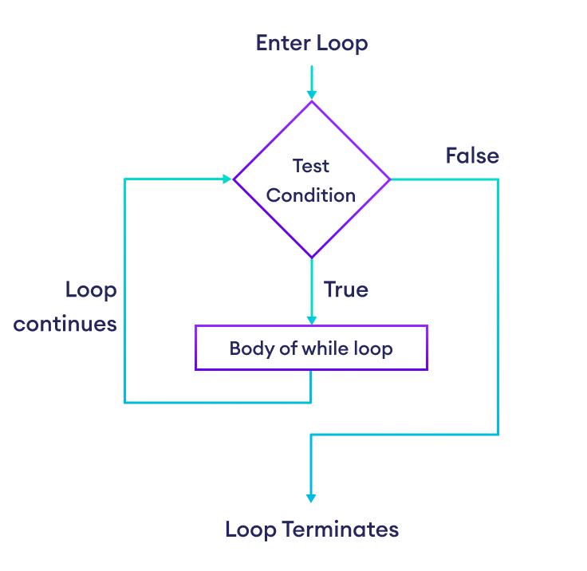
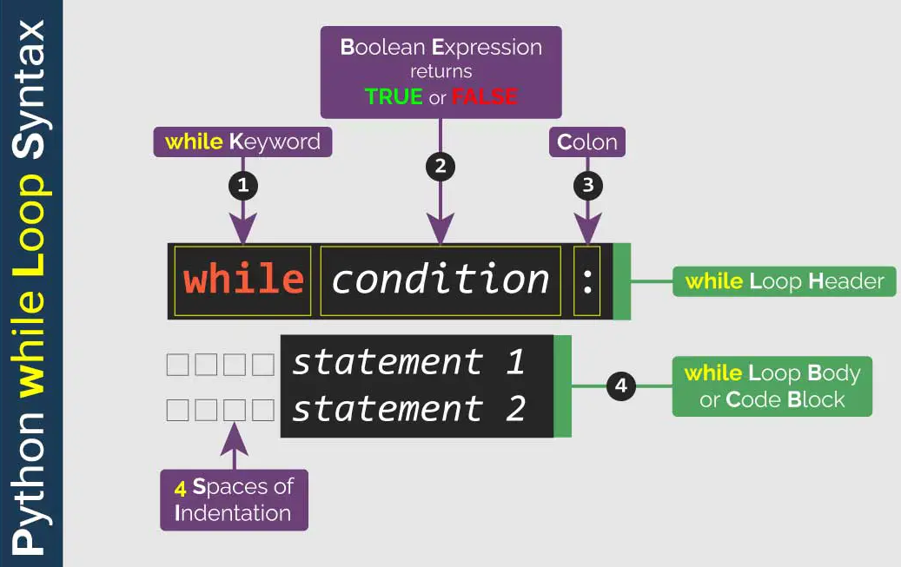
Python While Loop

Slide 40
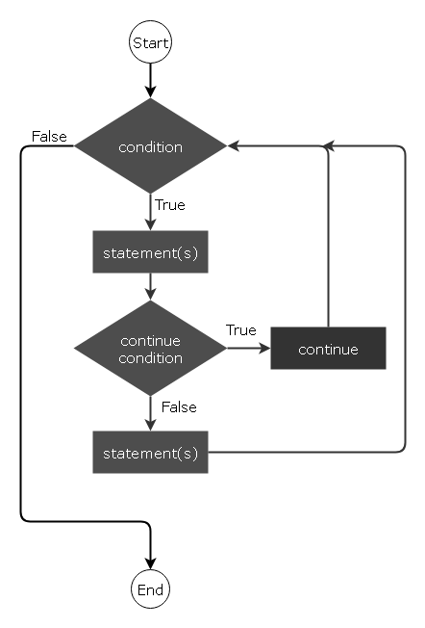
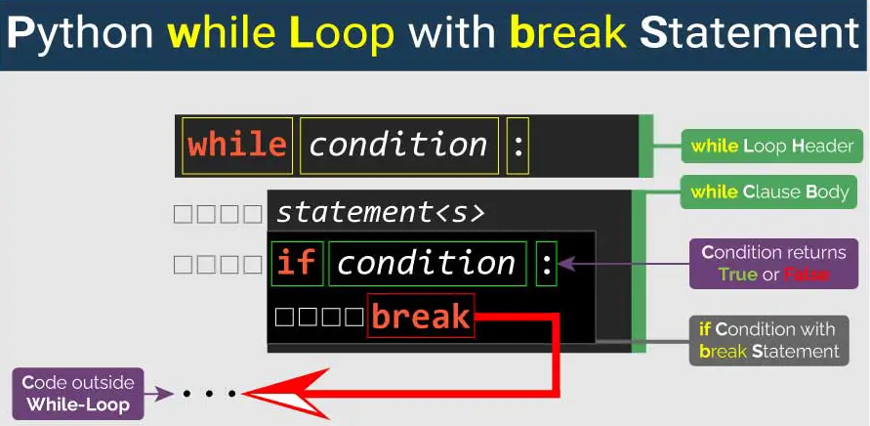
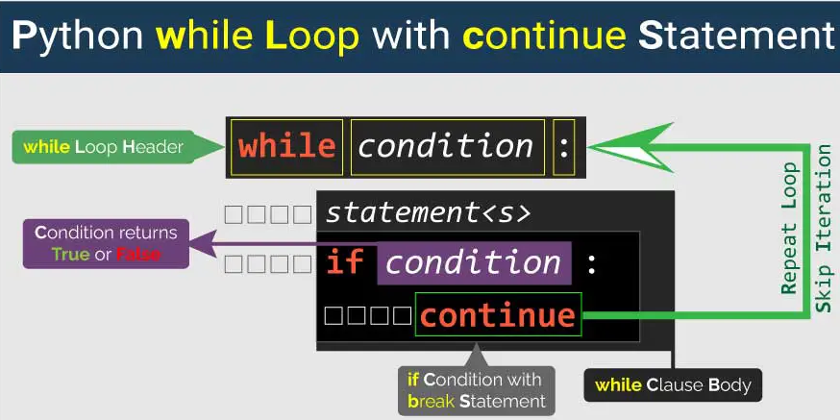
Python Loop Control Statements – While - Continue

Slide 41
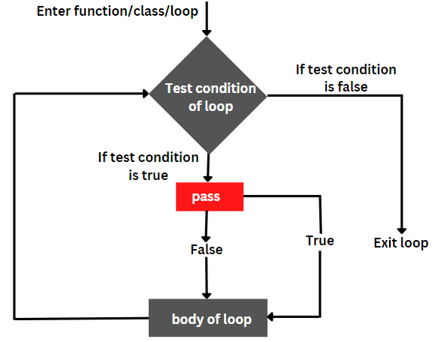
Python Loop Control Statements – While - Pass

Slide 42
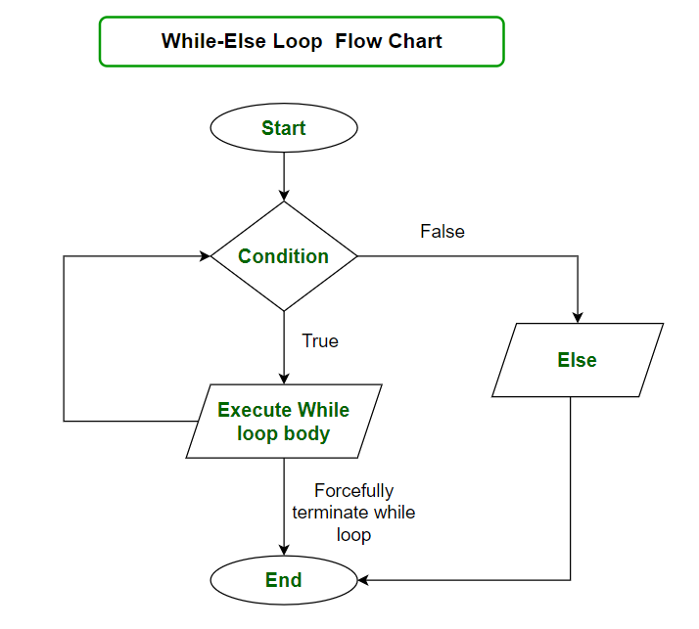
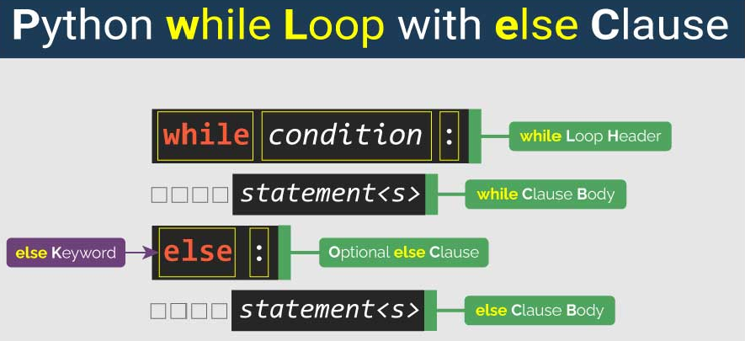
Python Loop Control Statements – While - Else

Slide 43
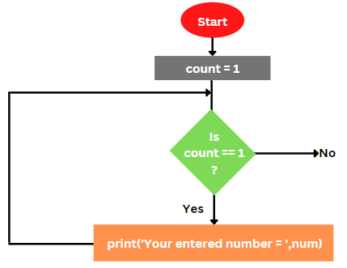
While infinite Loop

Slide 44
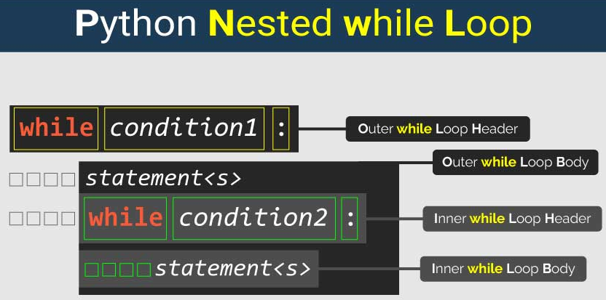
Python – Nested While Loop

Slide 45
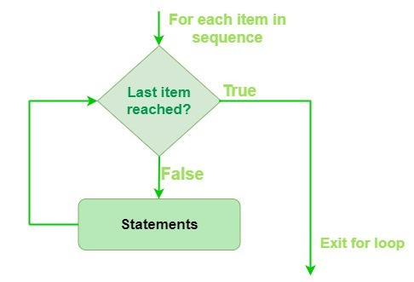
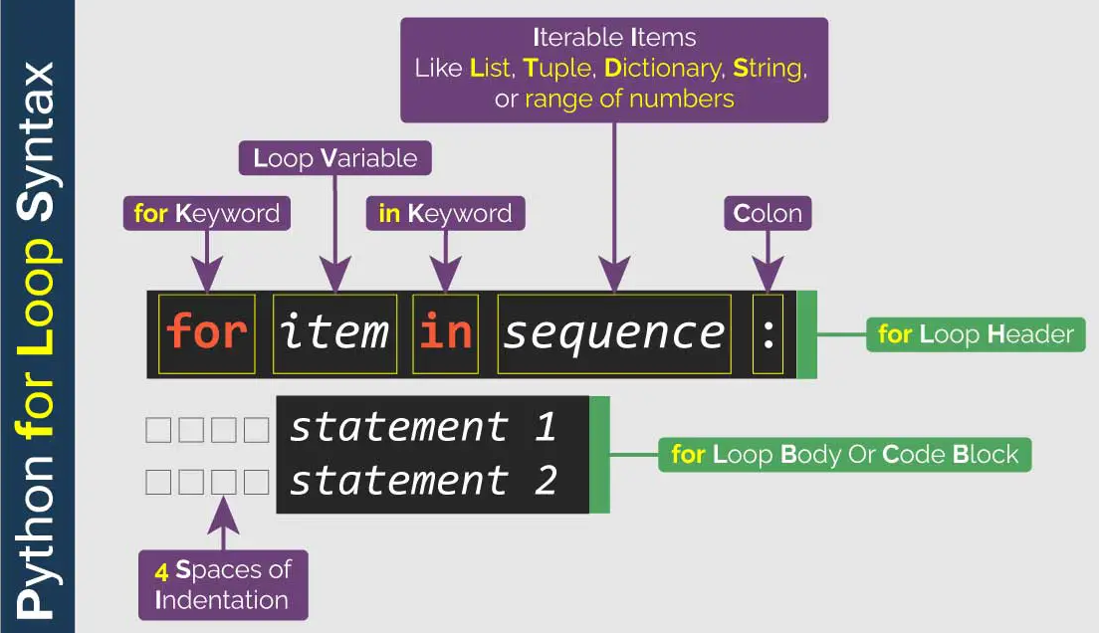
Python - For Loop

Slide 46
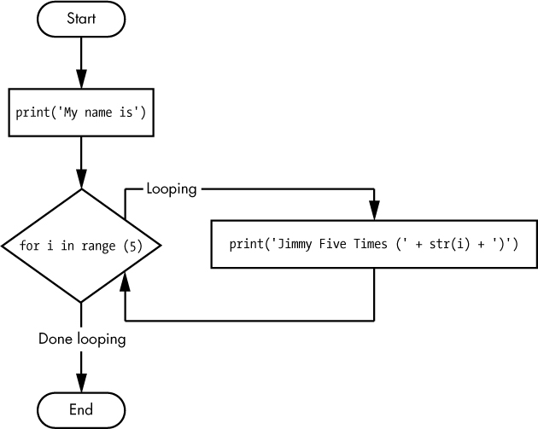
For Loop - Range

Slide 47
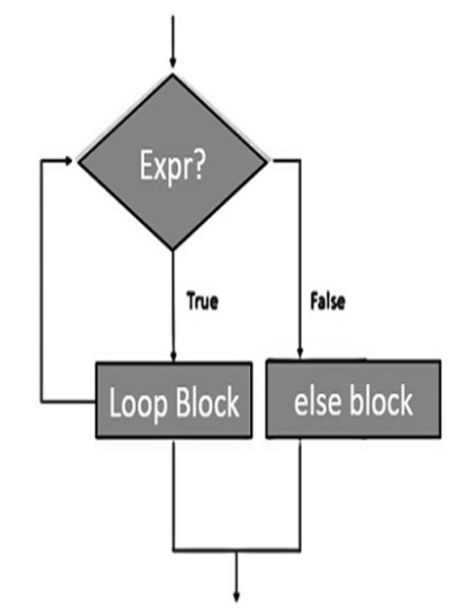
For Loop - Else

Slide 48
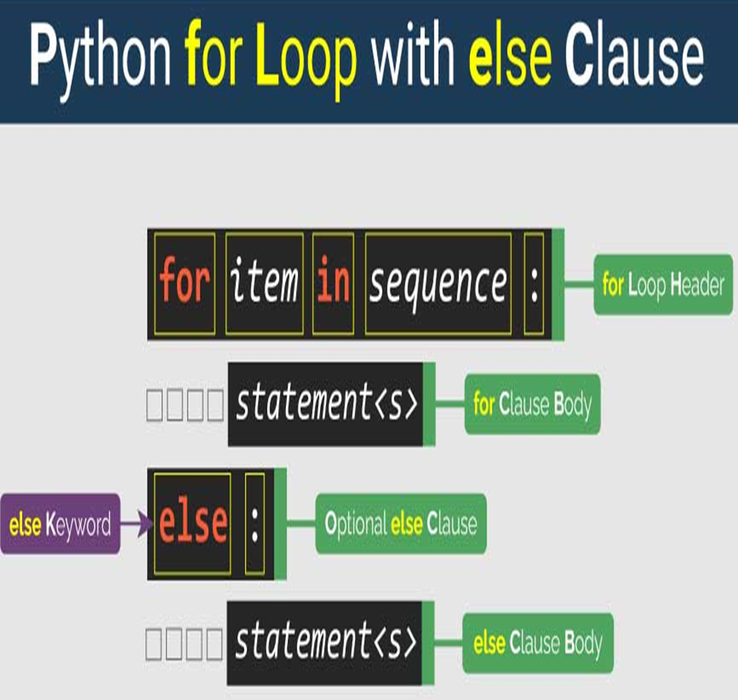
For Loop - Else

Slide 49
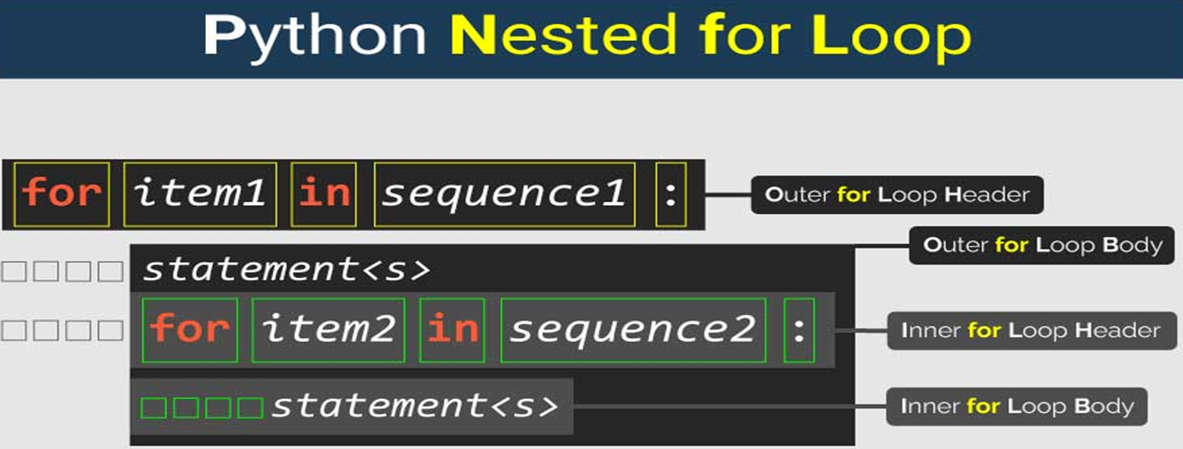
Python – Nested For Loop

Slide 50
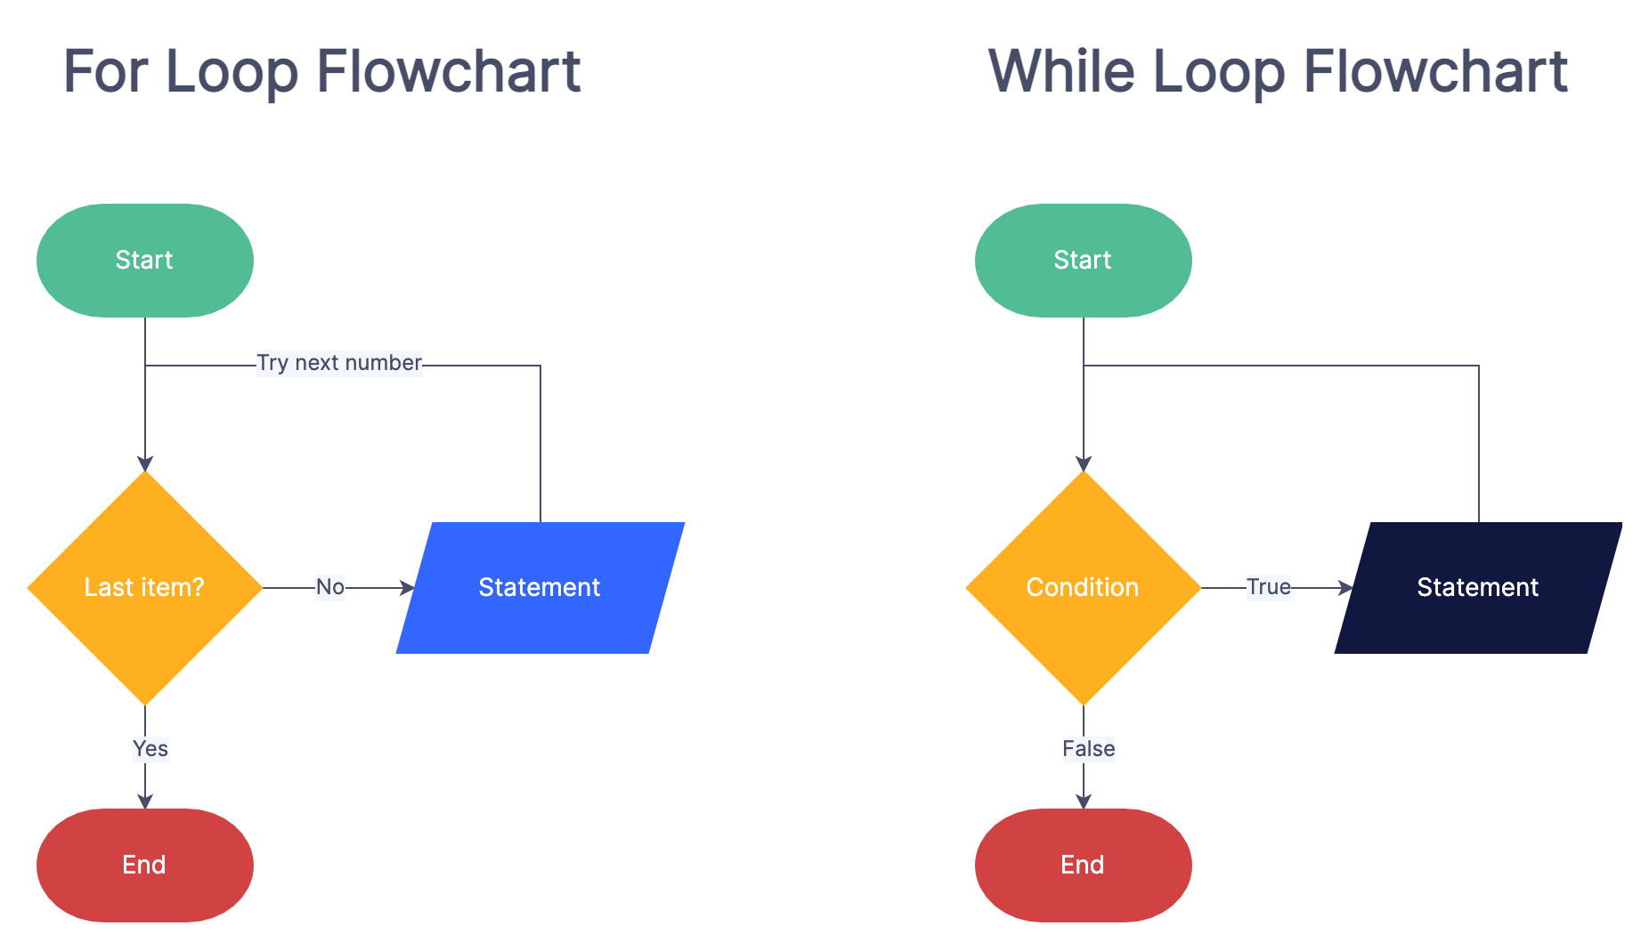
For Loop vs While Loop

Slide 51
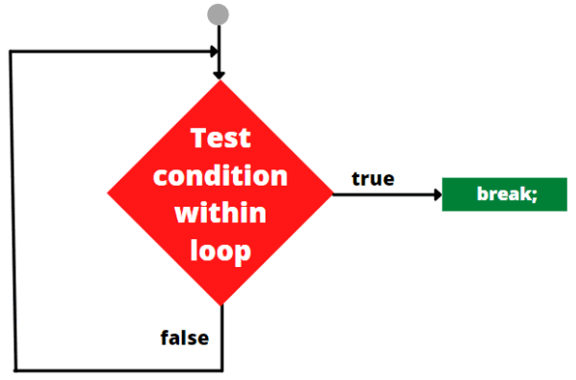
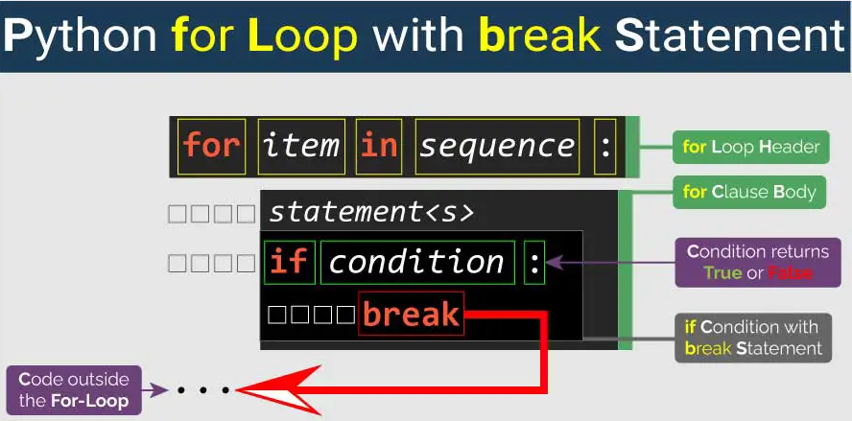
Python Loop Control Statements - Break

Slide 52
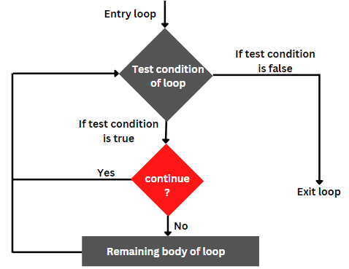
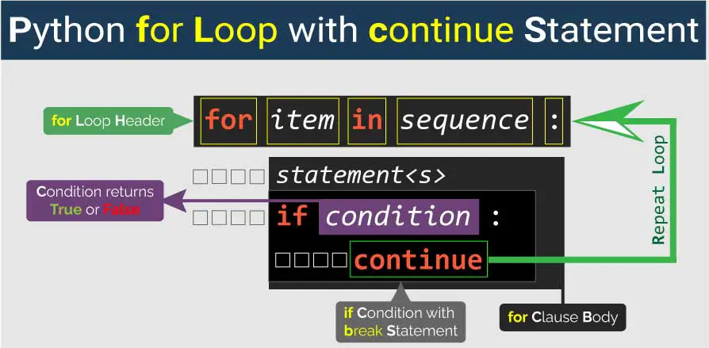
Python Loop Control Statements - Continue

